Slide 1

Classification of Income: Parametric and Nonparametric Machine Learning Models
Dongyang Wang

Slide 2
Outline
Background
Dataset
Methods
Results
Further steps

Slide 3
Project Background
Class Background: Stat 527 Nonparametric Regression and Classification. Covers techniques for smoothing and classification including spline models, kernel methods, generalized additive models, and the averaging of multiple models.
Project Goal: We seek to apply our knowledge in parametric and nonparametric machine learning methods and identify the best model to classify whether a person’s annual income exceeds $50k.
Team Members: Bohan Song, Dongyang Wang, Wenjin Zhang

Slide 4
Dataset
Adult Income Dataset
Data Source
Kaggle
Pulled from the UCI machine learning repository
Originally from US Census Bureau in 1996

Slide 5
Methods
EDA
Model Training
Model Evaluation
Challenges

Slide 6
Methods - EDA
Structure of Dataset
Removing NA’s
Feature Engineering
Elementary Visualization

Slide 7
Methods - EDA - Structure of Dataset
48,842 observations (7% have missing values)
15 variables
Classification: Income
Continuous
Age, weight in population, years of education, capital gain/loss, hours per week
Categorical
Work-class, education, marital status, occupation, relationship, race, sex, native country

Slide 8
Methods - EDA - Removing NA’s
Indicated by “?” in the original dataset
Removed all rows with NA entries
Mainly work-class and occupation

Slide 9
Methods - EDA - Feature Engineering
Converted income to levels of 1 and 0
Converted categorical data to factors (ordered)
Grouped countries by origins (continents)

Slide 10
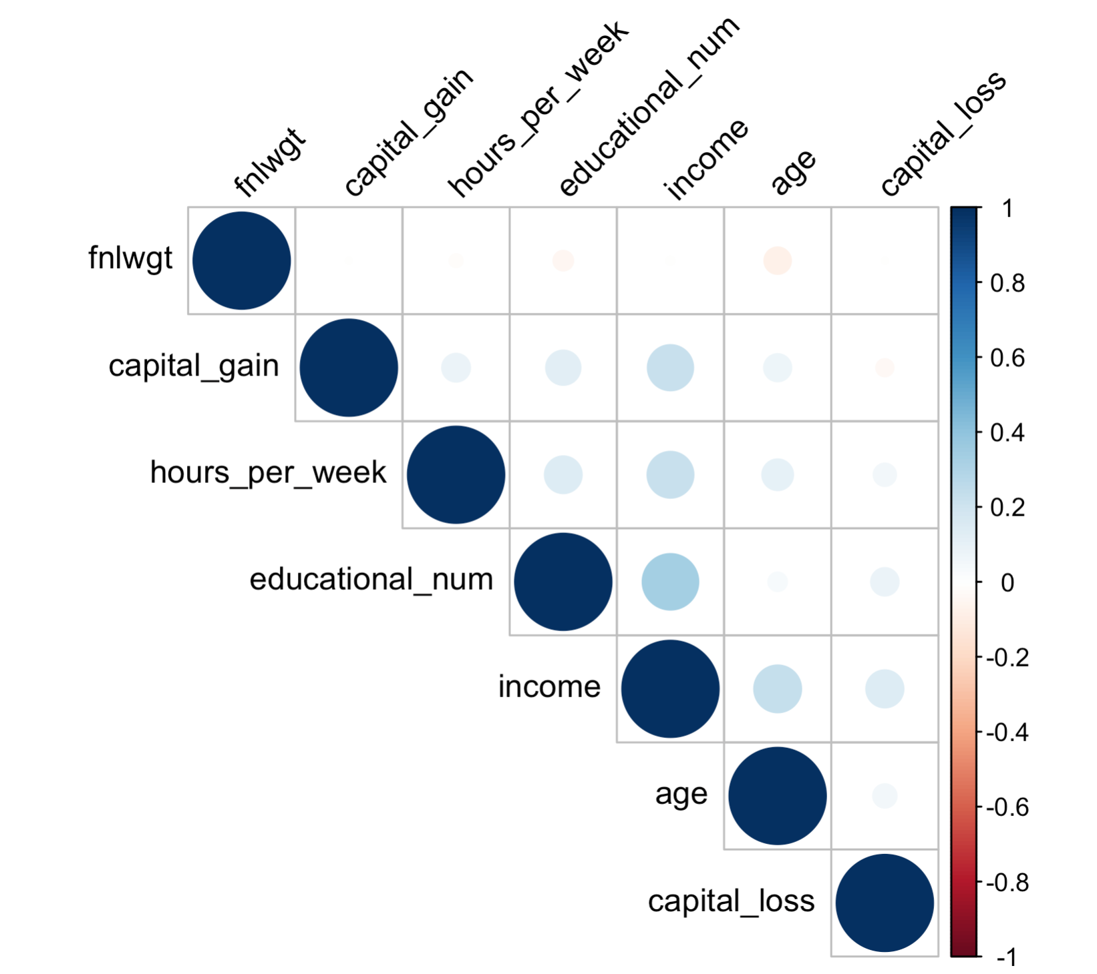
Methods - EDA - Elementary Visualization
Drew histograms to understand the key variables
Correlational plot to check if assumptions for Naïve Bayes is satisfied

Slide 11
Methods – Model Training
Train Test Split
80% train
64% train and 16% validation
20% test
Parametric Models
Nonparametric Models

Slide 12
Methods - Model Training - Parametric Models
Logistic Regression
Stepwise model based on full model and null model
Cross validation on accuracy for the best threshold
Naïve Bayes
Hand coded
Predict joint probability of all continuous/discrete random variables

Slide 13
Methods - Model Training - Nonparametric Models
Decision Tree
Cross validation on size of tree
KNN
Converted categorical variables to dummy variables
Cross validation on number of neighbors
Random Forest
Normalized heavy-tailed features
Used validation dataset on number of variables for split and maximal tree depth
SVM
Normalized numerical variables to facilitate running
Used validation dataset on cost of violations for different kernels

Slide 14
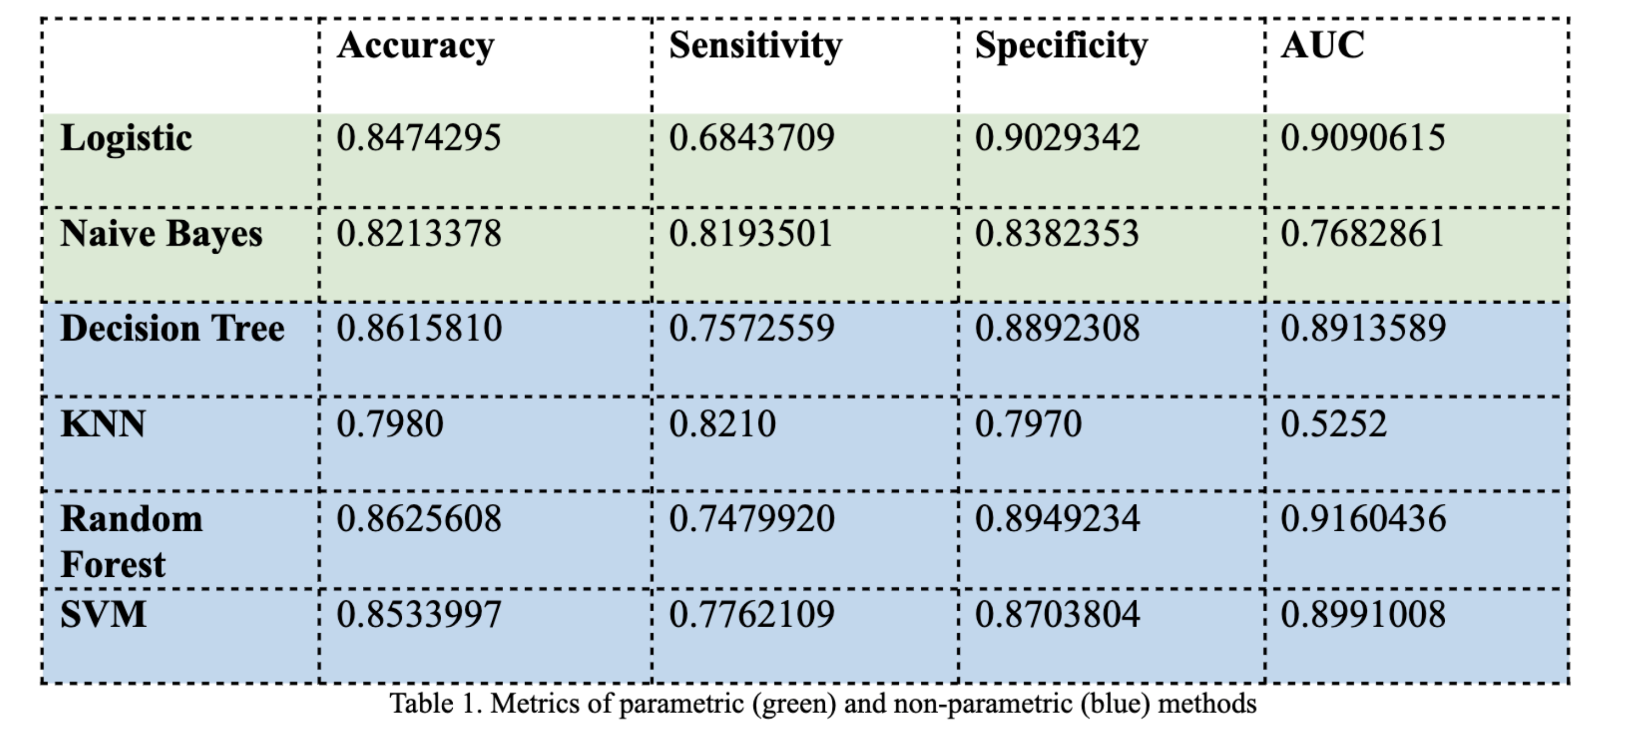
Methods – Model Evaluation

Slide 15
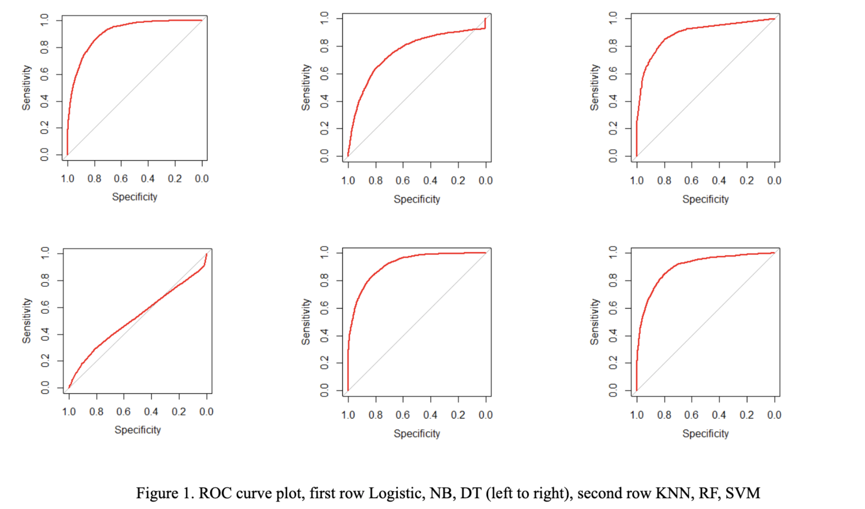
Methods – Model Evaluation

Slide 16
Methods – Challenges
Syntax in R
Runtime
Validation
Communication

Slide 17
Results
Worst performance: KNN
Number of features
Best performance: Random Forest
Speed
Accuracy
AUC
Potential questions to answer

Slide 18
Further Steps
Missing data
More models
Neural Networks
Gradient Boosting
Probit Model
In-depth tuning of hyperparameters

Slide 19
References
“Adult income dataset.” Kaggle. See https://www.kaggle.com/datasets/wenruliu/adult-income-dataset
“Is it essential to do normalization for SVM and Random Forest?” Stack Exchange. https://stats.stackexchange.com/questions/57010/is-it-essential-to-do-normalization-for-svm-and-random-forest
“The Adult dataset.” University of Toronto. http://www.cs.toronto.edu/~delve/data/adult/adultDetail.html

Slide 20
Thank you! & Q&A

